Slide 1

Ridge Regression Model for Boston Dataset
Mun-jung Kim, 20170396, Physics
Kyung-mi Na, 20170820, Mechanical engineering

Slide 2
Background

Slide 3
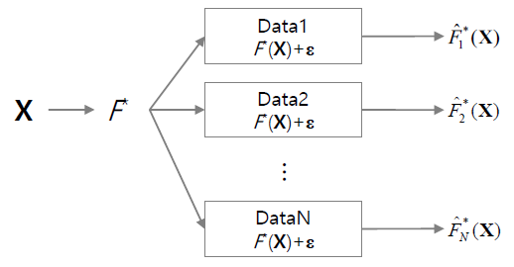
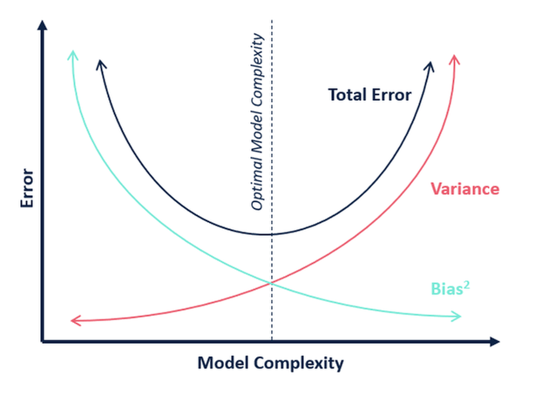

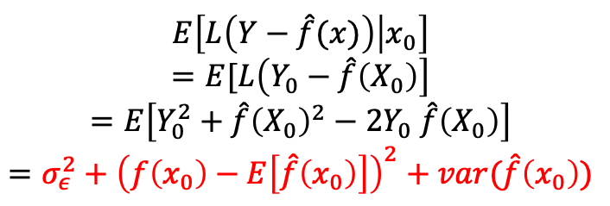

Bias Variance Decomposition
Train data $X$
New data $x_{0}$
$$E\left[L\left(Y−\hat{f}(x)\right) | x_{0}\right]$$
$$=E[L\left(Y_{0}−\hat{f}\left(X_{0}\right)\right]$$
$$=E\left[Y_{0}^{2}+\hat{f}{\left(X_{0}\right)}^{2}−2Y_{0} \hat{f}\left(X_{0}\right)\right]$$
$$=σ_{ε}^{2}+{\left(f\left(x_{0}\right)−E\left[\hat{f}\left(x_{0}\right)\right]\right)}^{2}+var(\hat{f}\left(x_{0}\right))$$

Slide 4
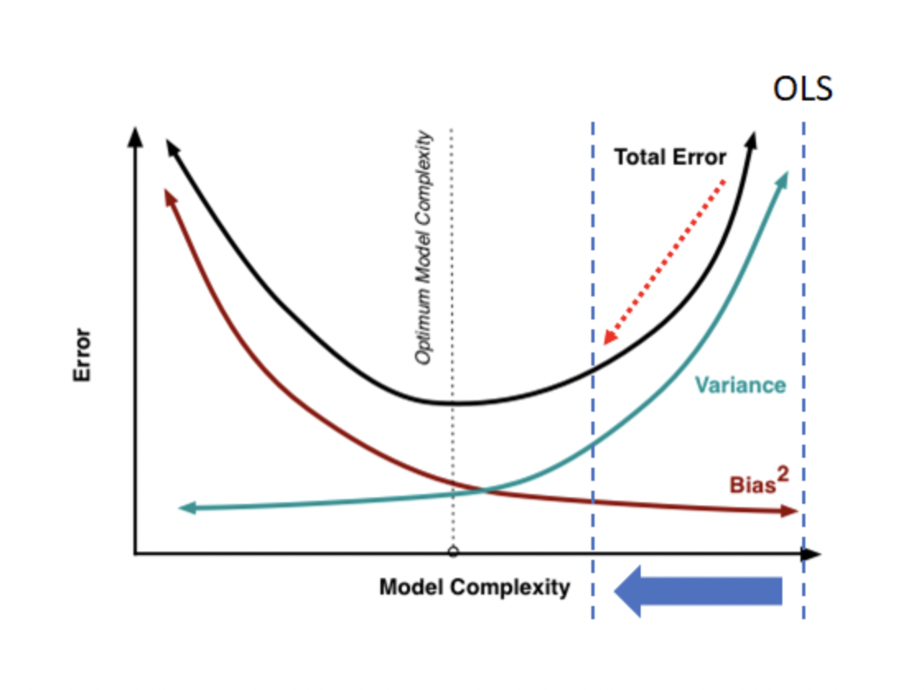
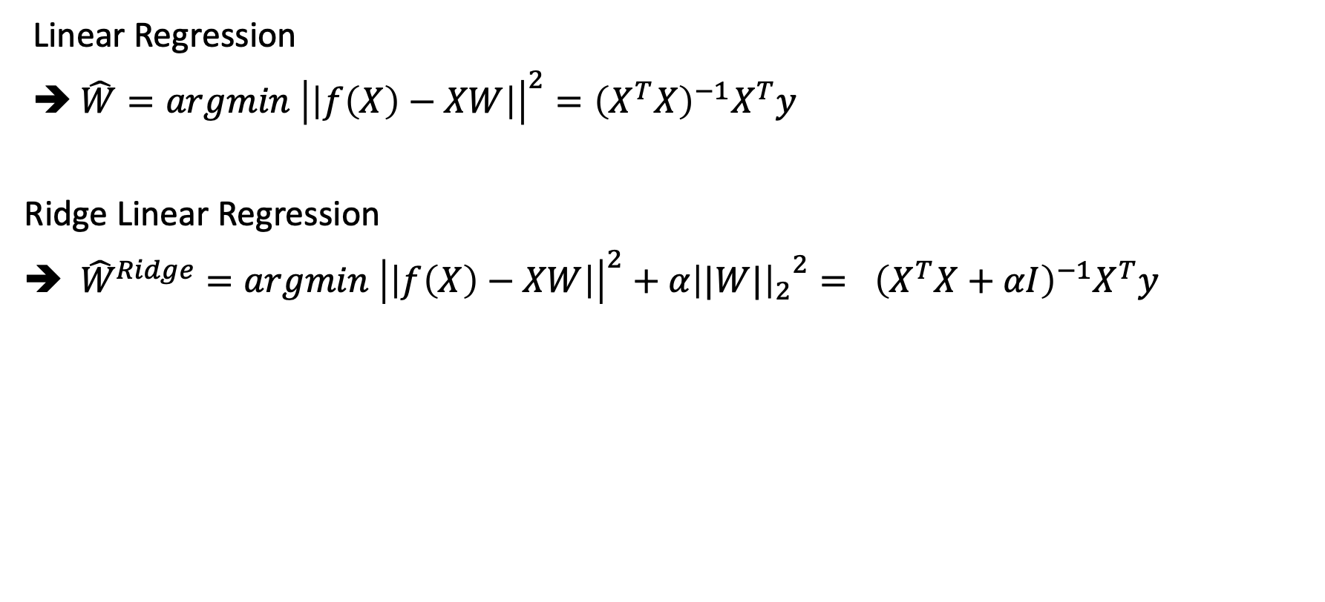
Ridge Linear Regression
Linear Regression
➔ $\hat{W}=argmin {\left|\left|f\left(X\right)−XW\right|\right|}^{2}={\left(X^{T}X\right)}^{−1}X^{T}y$
Ridge Linear Regression
➔ ${\hat{W}}^{Ridge}={argmin {\left|\left|f\left(X\right)−XW\right|\right|}^{2}+α{{\left||W|\right|}_{2}}^{2}= \left(X^{T}X+αI\right)}^{−1}X^{T}y$
Low Bias
High variance

Slide 5
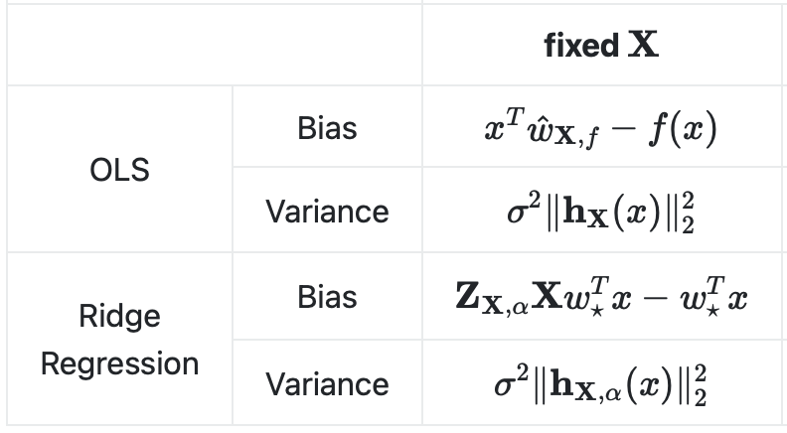
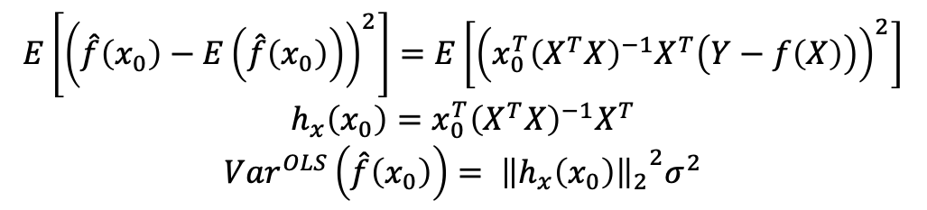
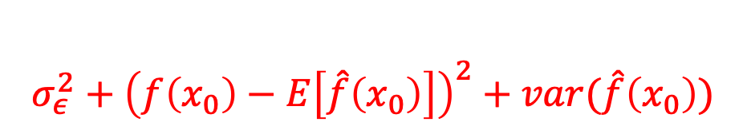
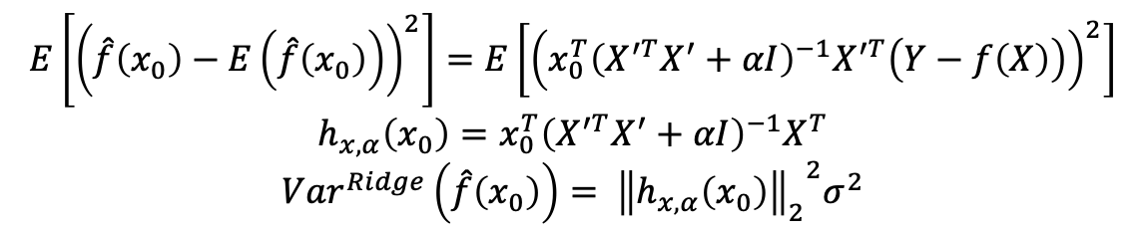
Vairance of Linear Regression
$$σ_{ε}^{2}+{\left(f\left(x_{0}\right)−E\left[\hat{f}\left(x_{0}\right)\right]\right)}^{2}+var(\hat{f}\left(x_{0}\right))$$
$$E\left[{\left(\hat{f}\left(x_{0}\right)−E\left(\hat{f}\left(x_{0}\right)\right)\right)}^{2}\right]=E\left[{\left(x_{0}^{T}{\left(X^{T}X\right)}^{−1}X^{T}\left(Y−f\left(X\right)\right)\right)}^{2}\right]$$
$$h_{x}\left(x_{0}\right)=x_{0}^{T}{\left(X^{T}X\right)}^{−1}X^{T}$$
$$Var^{OLS}\left(\hat{f}\left(x_{0}\right)\right)= {{\left\|h_{x}\left(x_{0}\right)\right\|}_{2}}^{2}σ^{2}$$
$$E\left[{\left(\hat{f}\left(x_{0}\right)−E\left(\hat{f}\left(x_{0}\right)\right)\right)}^{2}\right]=E\left[{\left(x_{0}^{T}{\left(X^{′T}X^{′}+αI\right)}^{−1}X^{′T}\left(Y−f\left(X\right)\right)\right)}^{2}\right]$$
$$h_{x,α}\left(x_{0}\right)=x_{0}^{T}{\left(X^{′T}X^{′}+αI\right)}^{−1}X^{T}$$
$$Var^{Ridge}\left(\hat{f}\left(x_{0}\right)\right)= {{\left\|h_{x,α}\left(x_{0}\right)\right\|}_{2}}^{2}σ^{2}$$

Slide 6
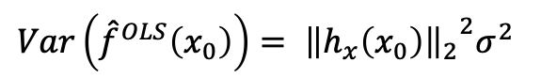
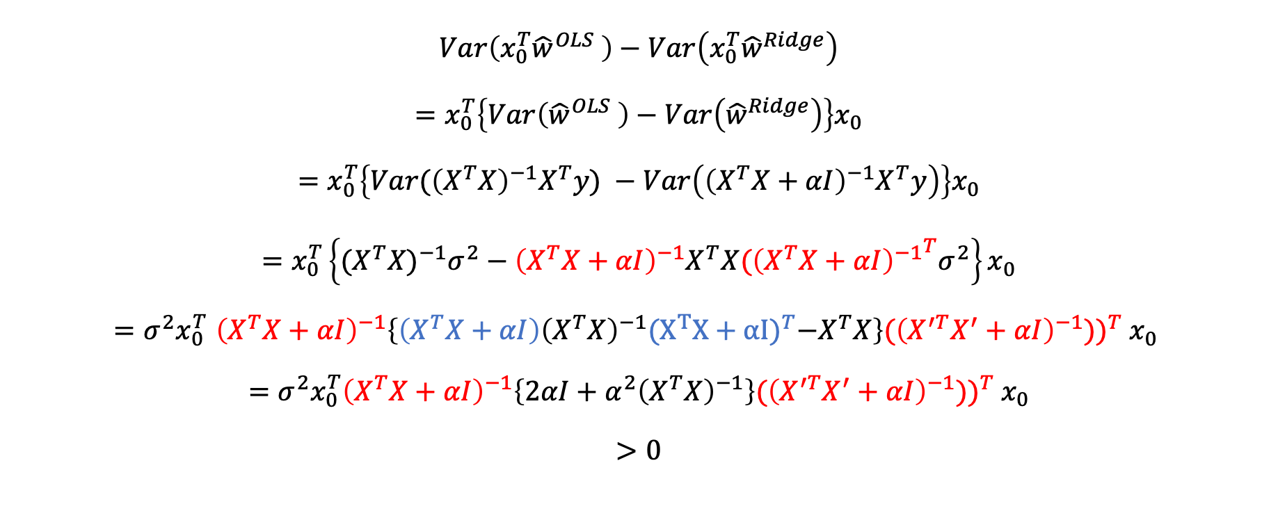
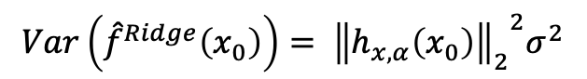
Variance of Ridge regression
$$Var\left({\hat{f}}^{OLS}\left(x_{0}\right)\right)= {{\left\|h_{x}\left(x_{0}\right)\right\|}_{2}}^{2}σ^{2}$$
$$Var\left({\hat{f}}^{Ridge}\left(x_{0}\right)\right)= {{\left\|h_{x,α}\left(x_{0}\right)\right\|}_{2}}^{2}σ^{2}$$
$$Var\left({x_{0}^{T}\hat{w}}^{OLS} \right)−Var\left({x_{0}^{T}\hat{w}}^{Ridge}\right)$$
$$=x_{0}^{T}\left\{Var\left({\hat{w}}^{OLS} \right)−Var\left({\hat{w}}^{Ridge}\right)\right\}x_{0}$$
$$=x_{0}^{T}\left\{Var{(\left(X^{T}X\right)}^{−1}X^{T}y\text{)} −Var\left({\left(X^{T}X+αI\right)}^{−1}X^{T}y\right)\right\}x_{0}$$
$$=x_{0}^{T}\left\{{{(X}^{T}X)}^{−1}σ^{2}−{\left(X^{T}X+αI\right)}^{−1}X^{T}X{{(\left(X^{T}X+αI\right)}^{−1}}^{T}σ^{2}\right\}x_{0}$$
$${=σ^{2}x}_{0}^{T}{\left(X^{T}X+αI\right)}^{−1}\left\{{\left(X^{T}X+αI\right)\left(X^{T}X\right)}^{−1}{(X^{T}X+αI)}^{T}−X^{T}X\right\}{(\left(X^{′T}X^{′}+αI\right)}^{−1}))^{T} x_{0}$$
$$={σ^{2}x}_{0}^{T}{\left(X^{T}X+αI\right)}^{−1}\left\{2αI+α^{2}{\left(X^{T}X\right)}^{−1}\right\}{(\left(X^{′T}X^{′}+αI\right)}^{−1}))^{T} x_{0}$$
$$>0$$

Slide 7
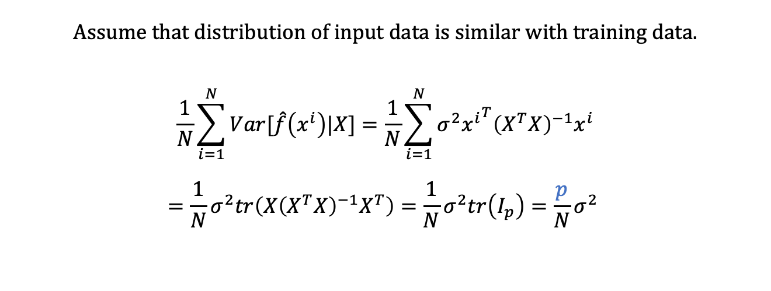
Variance of linear regression
$$σ_{ε}^{2}+{\left(f\left(x_{0}\right)−E\left[\hat{f}\left(x_{0}\right)\right]\right)}^{2}+var(\hat{f}\left(x_{0}\right))$$
Assume that distribution of input data is similar with training data.
$$\frac{1}{N}\sum_{i=1}^{N}{Var[\hat{f}\left(x^{i}\right)|X]}=\frac{1}{N}\sum_{i=1}^{N}{σ^{2}{x^{i}}^{T}{\left(X^{T}X\right)}^{−1}x^{i}}$$
$$=\frac{1}{N}σ^{2}tr\left(X{\left(X^{T}X\right)}^{−1}X^{T}\right)=\frac{1}{N}σ^{2}tr\left(I_{p}\right)={\frac{p}{N}σ}^{2}$$

Slide 8
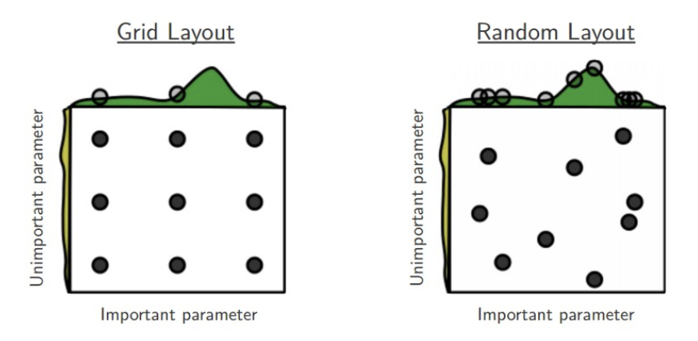
Grid Search
Hyper parameter optimization

Slide 9
Data analysis
Objective : Build a simple Ridge regression model for Boston dataset. Use grid search to select best “regularization” hyperparameter

Slide 10
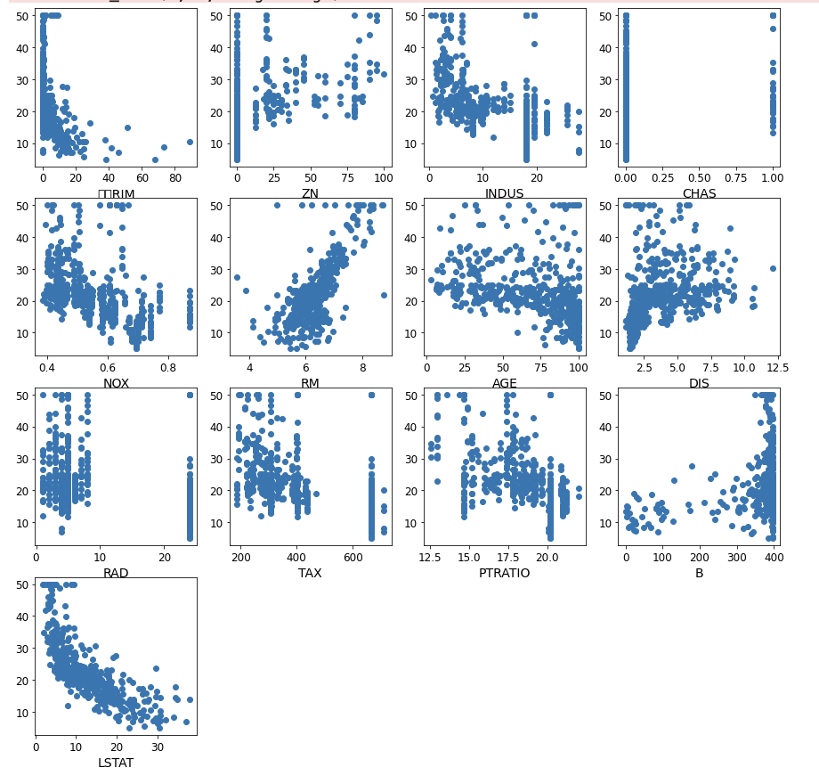
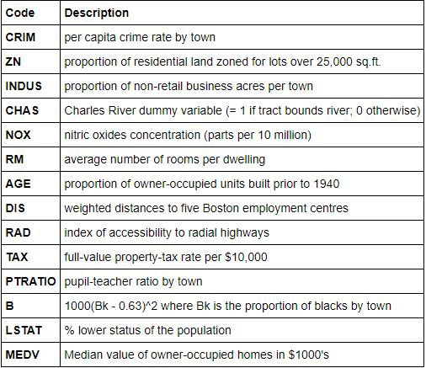
Data
Boston houseprice Dataset : https://www.kaggle.com/c/boston-housing
* Total 13 variates

Slide 11
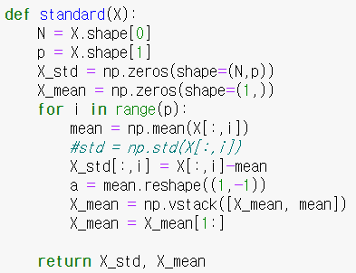
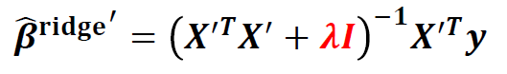
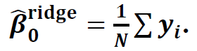
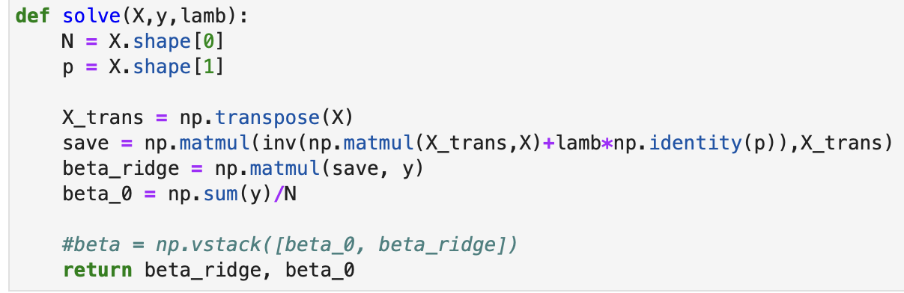
Ridge regression
Standardization process subtract mean of each column
How to find solution
Using these solution, calculate beta_ridge
beta_0 comes from calculating an arithmetic mean of output values.

Slide 12
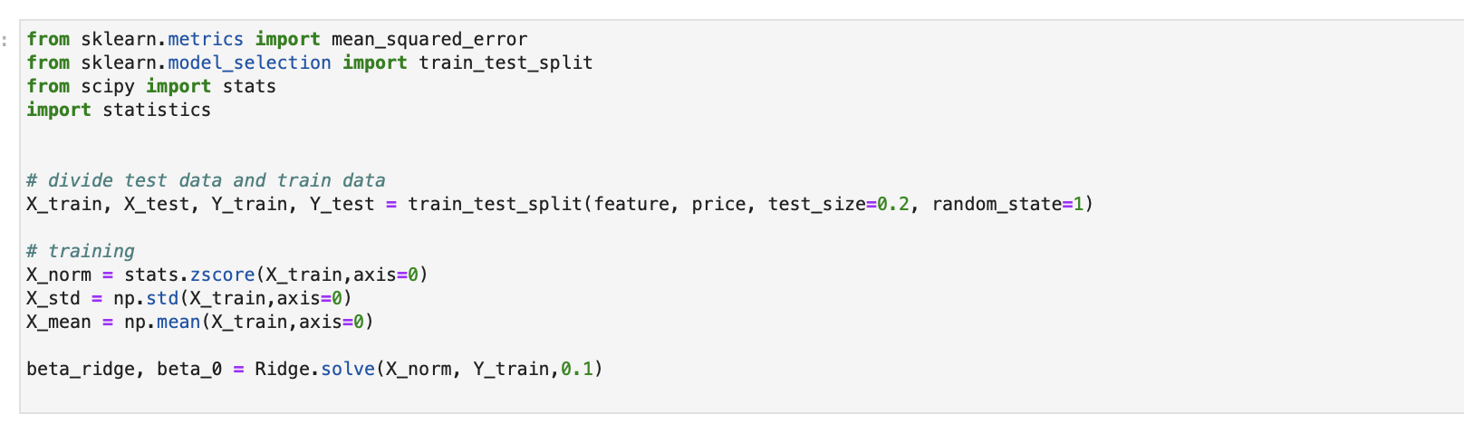
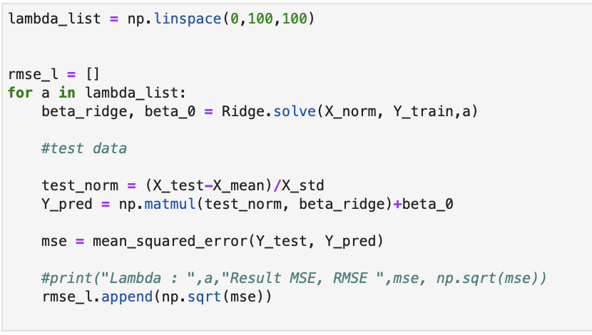
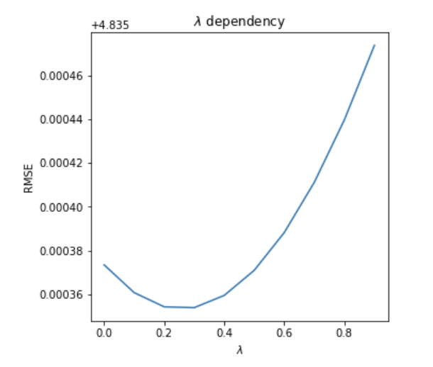
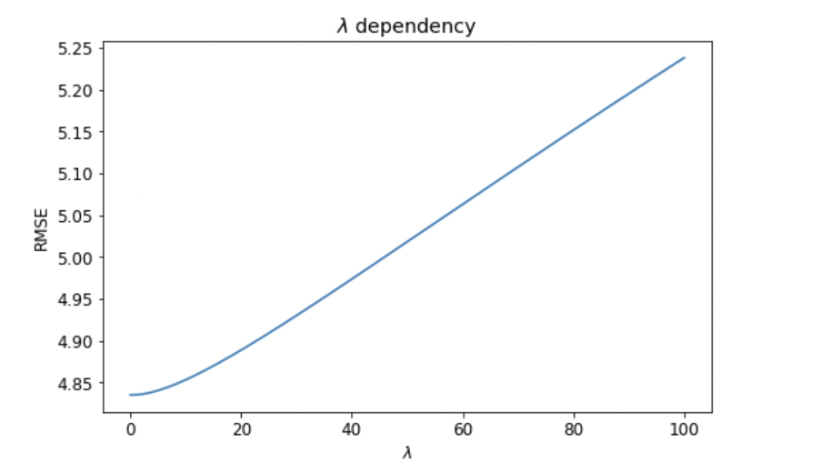
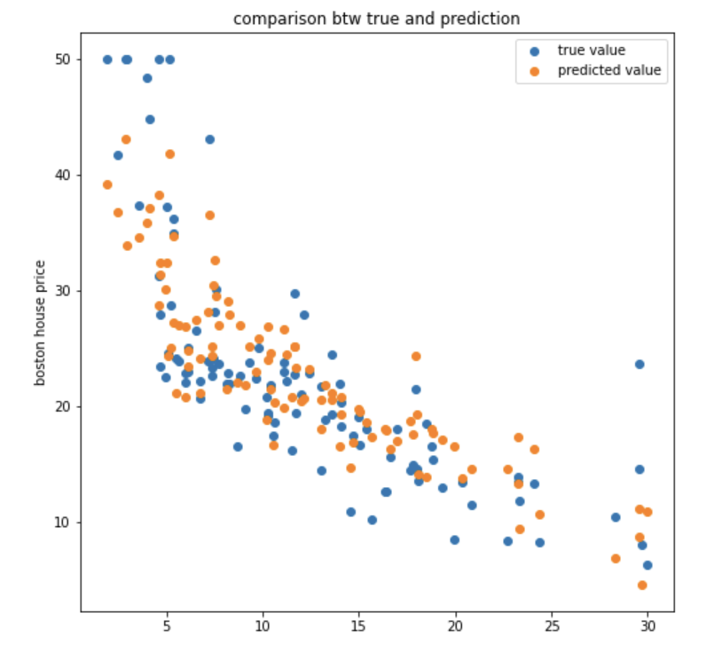
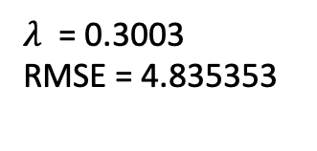
Ridge regression(Train : 0.8)
Train : Test = 0.8 : 0.2
lambda_list = np.linspace(0,100,1000)
$λ$dependency
$λ$ = 0.3003
RMSE = 4.835353

Slide 13
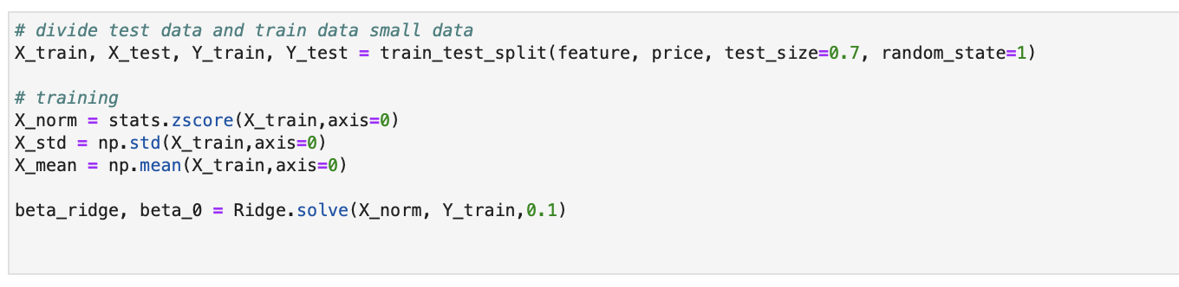
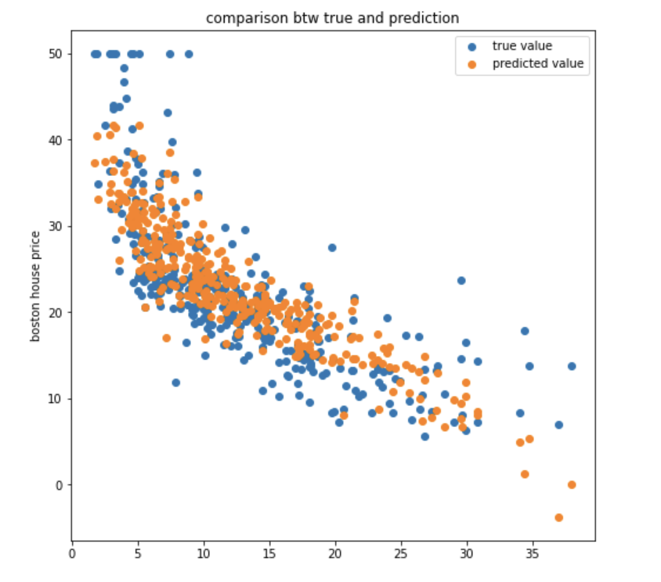
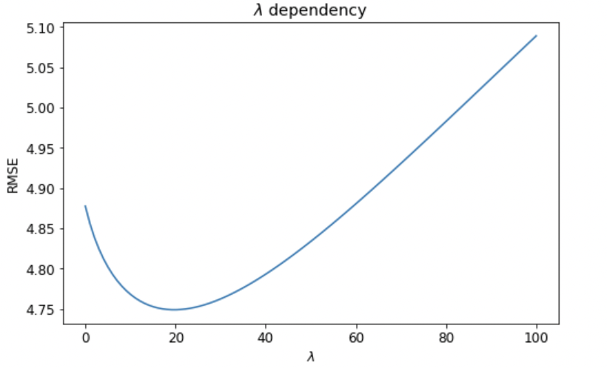
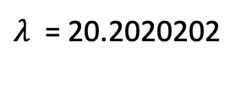
Ridge regression(Train : 0.3)
Train : Test = 0.3 : 0.7
lambda_list = np.linspace(0,100,1000)
$λ$dependency
$λ$ = 20.2020202
RMSE = 4.749004

Slide 14
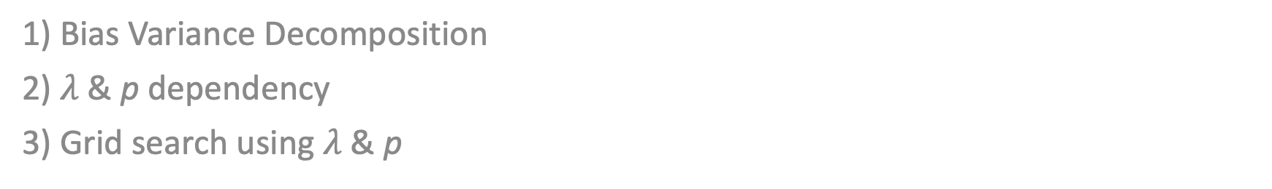
Additional experiment
1) Bias Variance Decomposition
2) $λ$& p dependency
3) Grid search using $λ$& p

Slide 15
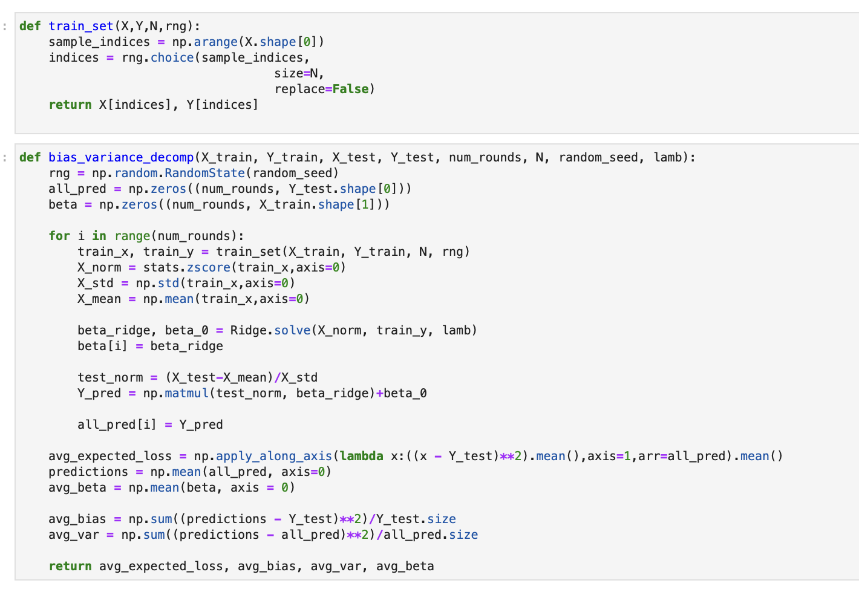
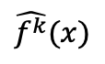
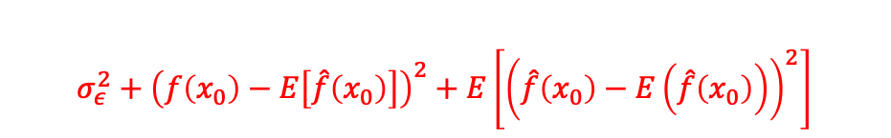
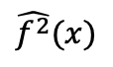
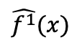
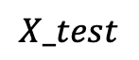
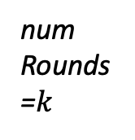
Bias Variance Decomposition
$$σ_{ε}^{2}+{\left(f\left(x_{0}\right)−E\left[\hat{f}\left(x_{0}\right)\right]\right)}^{2}+E\left[{\left(\hat{f}\left(x_{0}\right)−E\left(\hat{f}\left(x_{0}\right)\right)\right)}^{2}\right]$$
num_rounds : # of training set
N : size of training set
$$X_test$$
$$\hat{f^{1}}(x)$$
all_pred
$$\hat{f^{2}}(x)$$
num
Rounds
=$k$
.
.
.
$$\hat{f^{k}}(x)$$

Slide 16
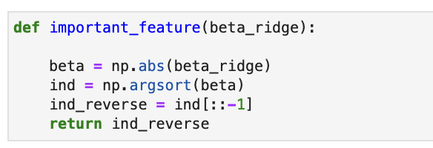
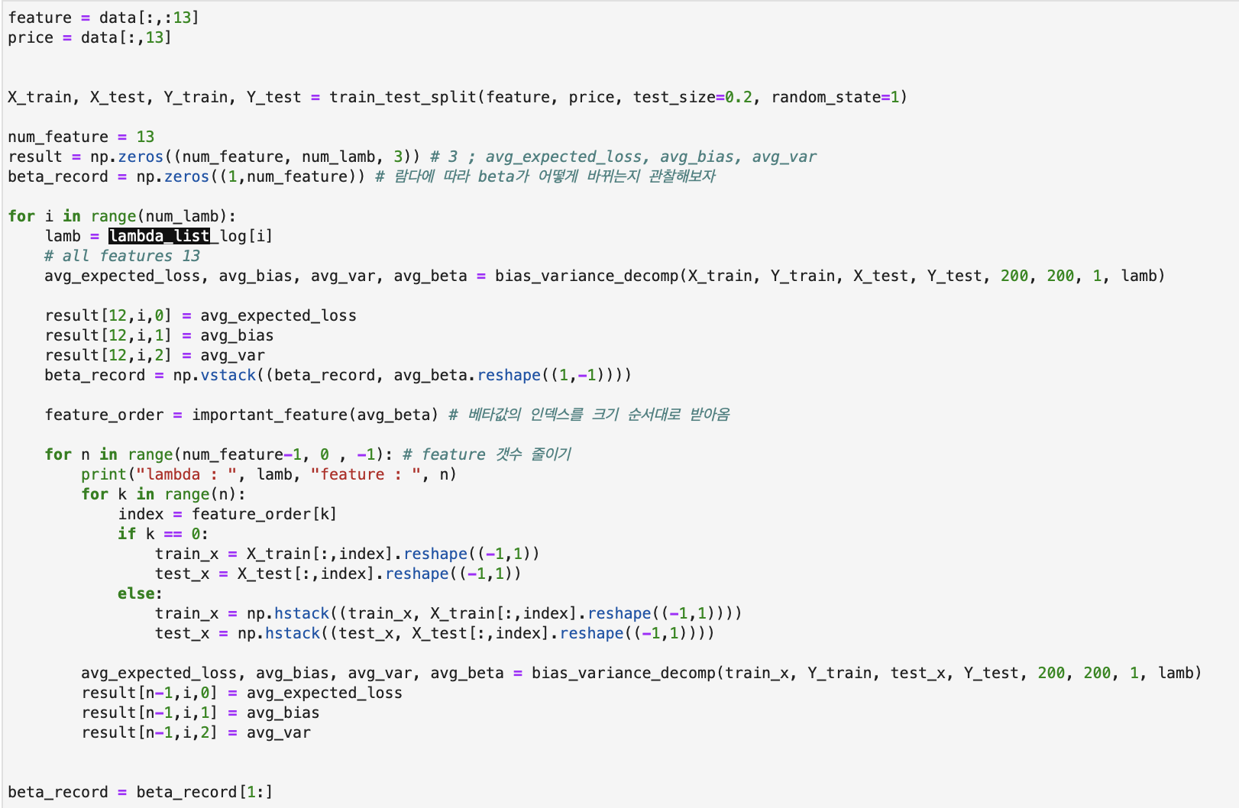
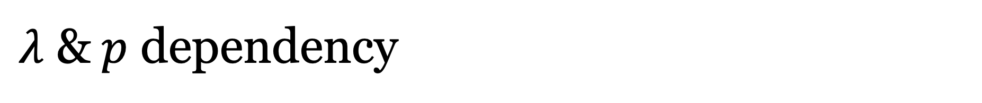
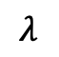
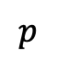
$λ$ &$p$ dependency
$$λ$$
result[0]
$$p$$
result[0]➔ MSE
result[1]➔bias
result[2]➔ variance

Slide 17
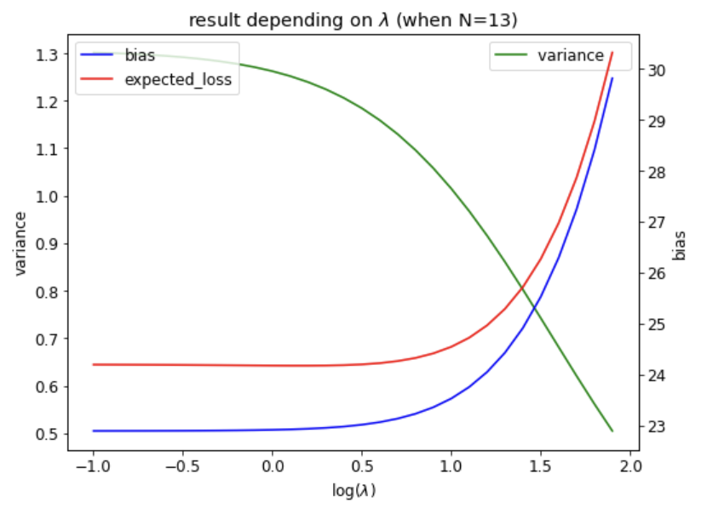
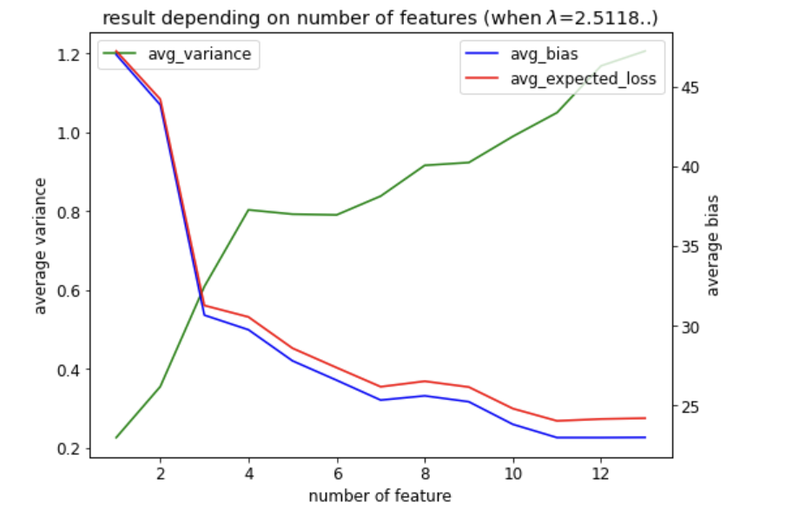
$λ$ &$p$ dependency

Slide 18
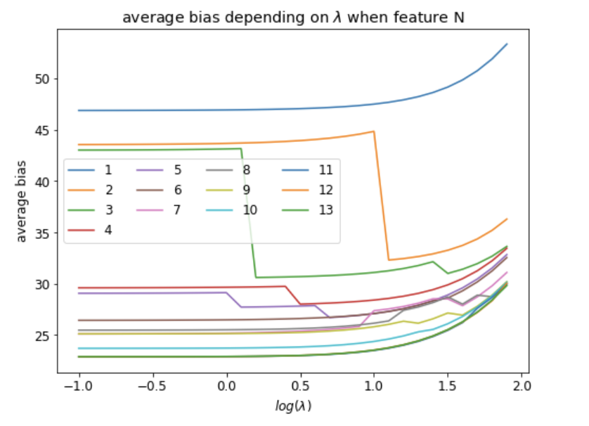
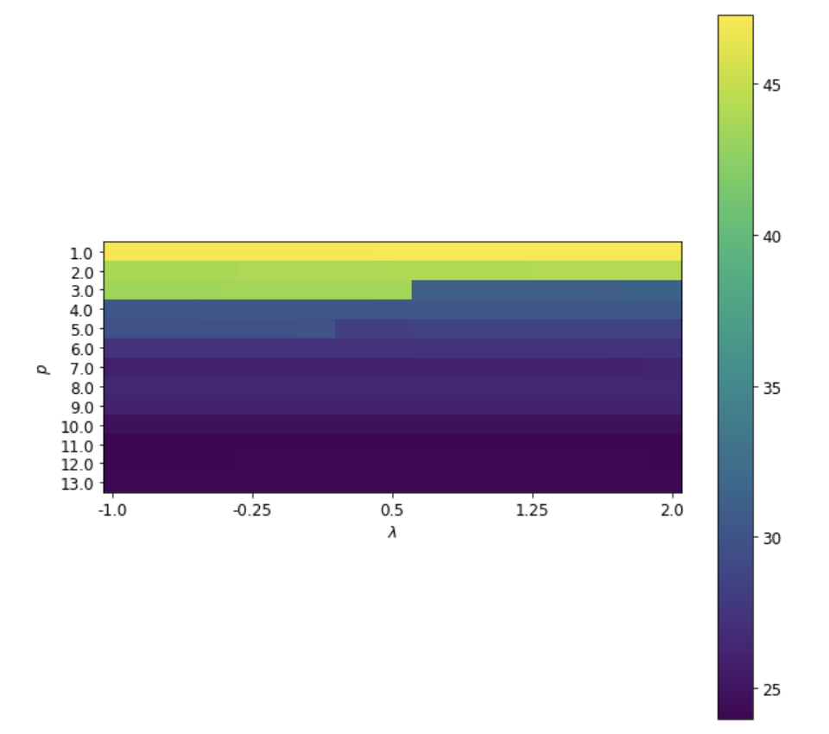
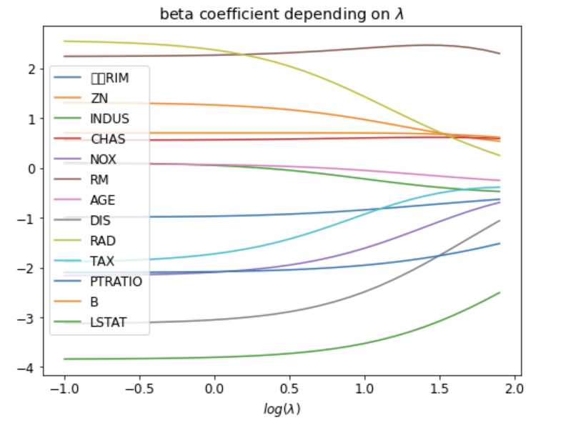
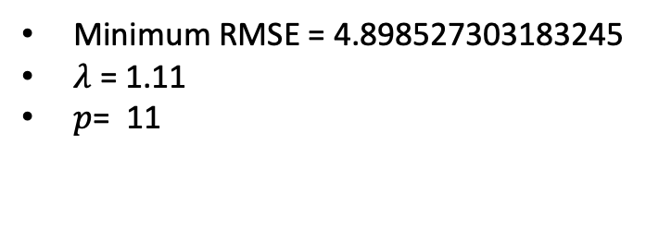
Number of feature dependency
Minimum RMSE = 4.898527303183245
$λ$ = 1.11
$p$= 11

Slide 19
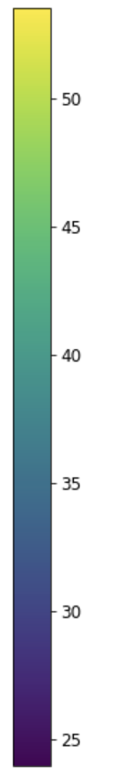






Summary
Window size should cover at least one period.
Interpretation of the coefficient
Why should lambda ?
$λ$ = 20.20202
$λ$ = 0.3003
RMSE = 4.749004
RMSE = 4.835353
Ridge regression can adjust overfitting
by insufficient data
$λ$ dependency
$p$ dependency
$λ\&p$grid search

Slide 20

Discussion
$$Var\left({x_{0}^{T}\hat{w}}^{OLS} \right)−Var\left({x_{0}^{T}\hat{w}}^{Ridge}\right)$$
$${{=σ}^{2}x}_{0}^{T}{\left(X^{T}X+λI\right)}^{−1}\left\{2λI+λ^{2}{\left(X^{T}X\right)}^{−1}\right\}{(\left(X^{′T}X^{′}+λI\right)}^{−1}))^{T} x_{0}$$
➔ Variance decreases as lambda increases
$$\frac{1}{N}\sum_{i=1}^{N}{Var[\hat{f}\left(x_{0}\right)|X]}=\frac{1}{N}σ^{2}tr\left(I_{p}\right)={\frac{p}{N}σ}^{2}$$
➔ Variance increases as p increases
➔ By and large, variance is very small

Slide 21
Thank you

